Slide 1
Block Diagram of 8051 Microcontroller

Slide 2
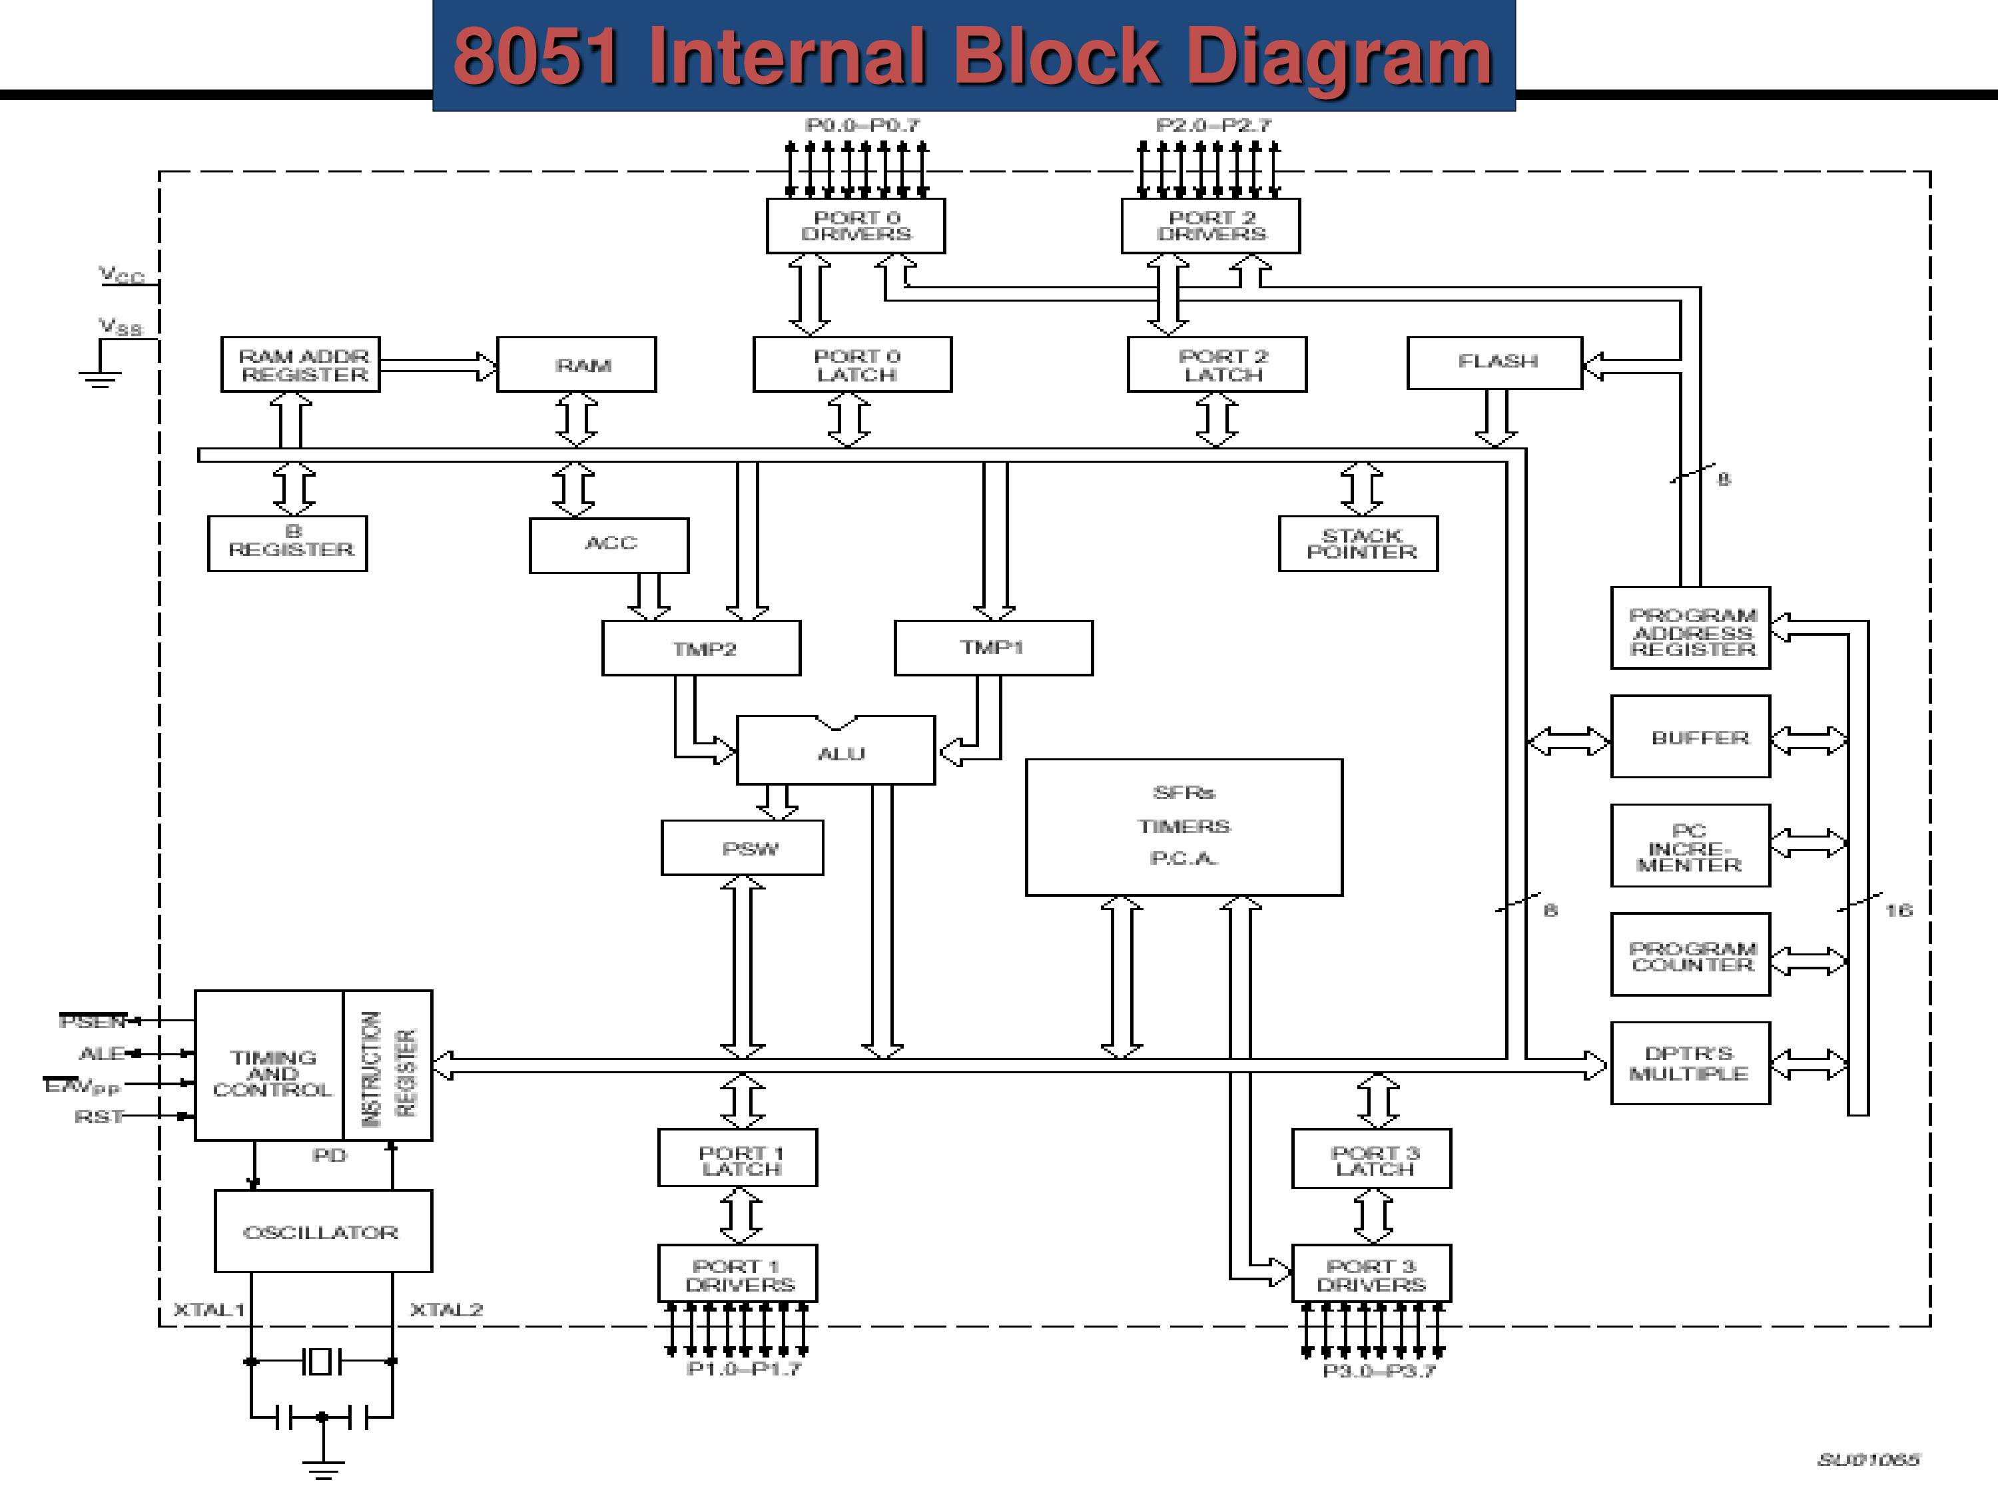
Architecture/Block diagram of 8051 Microcontroller

Slide 3
8051 Microcontroller has 8-bit data bus and 16-bit address bus. Data bus is used to carry the data and address bus is used to carry the addresses. 8051 has four ports. Each port having a driver (buffer) and a latch. They are 8-bit ports. These are bidirectional ports. It has different registers and memory (RAM, ROM), for ROM, there is no address register but for RAM there is address register, also different registers, ALU, Program status word (PSW), stack pointer (SP) and also some special functions registers. It has also data pointer, program counter and program address register, timing and control unit, instruction register in it. Timing and control unit provides various control signals like PSEN, ALE etc. It has oscillator. To the oscillator crystal is connected. Oscillator generates clock pulse and this clock pulse will provide different registers of 8051.

Slide 4
Microcontrollers are the soul of an Embedded System. Embedded systems are an integration of Hardware and Software, where the software is generally “embedded” into the hardware part. However, they are nothing without a Microcontroller or a Microprocessor. They are the component of an embedded system which fetch the instructions and execute them. Microcontrollers take the inputs for a system, and process the outputs.
The 8051 Microcontroller is a general purpose Microcontroller. Though it is more than 40 years old, the 8051 microcontroller is still heavily used in a number of electronic and electrical devices. Moreover various industries such as automobile, mobile communications, defense, aeronautics, and even healthcare, would be inefficient without this small but powerful component. So now you must be wondering, what are the qualities of the 8051 Microcontroller that makes it so irresistible to these gadgets and industries.

Slide 5
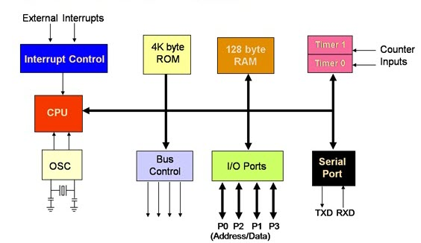
The reasons for the popularity of 8051 Microcontroller are –
Simple to integrate in any electronic device.
Affordable.
Simple architecture.
Easy instruction set.
Low computing power.

Slide 6
8-bit Microcontroller
The 8051 Microcontroller is an 8-bit Microcontroller. This signifies that the width of the data bus is 8-bits. The data bus is utilized to carry data from specific operations. Consequently, the CPU can process 8 bits of data at one time.
Central Processor Unit (CPU)
As we know that the CPU is the brain of any processing device of the microcontroller. It monitors and controls all operations that are performed on the Microcontroller units. The user has no control over the work of the CPU directly . It reads program written in ROM memory and executes them and do the expected task of that application.

Slide 7
Memory
A Microcontroller needs program memory to store program/instructions to perform defined tasks. This memory is termed as ROM. Furthermore the Microcontroller also requires data memory to store the operands/data on a temporary basis. This memory is known as RAM. The 8051 Microcontroller is built with 4 KB on-chip Read Only Memory (ROM) and 128 bytes Random Access Memory (RAM).
Bus
A bus of the Microcontroller can be defined as a group of wire which can act as a medium for the transfer of data. There are two buses present in the 8051 Microcontroller. While we are already aware of the Data Bus. The address bus is used to address memory locations and it is 16-bit wide. Furthermore, the address bus can also be used to transfer data from the CPU (Central Processing Unit) to the memory. Hence, for obvious reasons the address bus is unidirectional.

Slide 8
Interrupts
As its name suggests, Interrupt is a subroutine call that interrupts of the microcontrollers main operations or work and causes it to execute any other program, which is more important at the time of operation. The feature of Interrupt is very useful as it helps in case of emergency operations. An Interrupts gives us a mechanism to put on hold the ongoing operations, execute a subroutine and then again resumes to another type of operations.
The Microcontroller 8051 can be configured in such a way that it temporarily terminates or pause the main program at the occurrence of interrupts. When a subroutine is completed, Then the execution of main program starts.

Slide 9
The most powerful attribute of the 8051 Microcontroller is the concept of Interrupts. The interrupt is a mechanism to –
Temporarily suspend the ongoing program,
Pass the control to a subroutine,
Execute the subroutine,
Resume the ongoing/main program.
Interrupts can be of various types, such as, Software and Hardware interrupts, Non-maskable and maskable interrupts, etc. Now the 8051 Microcontroller incorporates five interrupts. These are :
INT0 – External Hardware Interrupt.
TF0 – Timer 0 Overflow Interrupt.
INT1 – External Hardware Interrupt.
TF1 – Timer 1 Overflow Interrupt.
R1/T1 – Serial communication Interrupt.

Slide 10
Input/Output Ports –
The 8051 Microcontroller needs to be connected to the peripheral devices in order to control their operations. The I/O Ports are responsible for the connection of the Microcontroller to its peripheral devices. There are total four 8-bit Input/Output Ports present in this Microcontroller.
Additionally, these are some important features of 8051 microcontroller given as follows :
Two 16-bit Timers and Counters.
A Data Pointer and a Program Counter of 16-bit each.
Four Register banks.
31 General Purpose Registers which are of 8-bit each.

Slide 11
8051 has a flag register to indicate arithmetic conditions such as the carry bit. The flag register in the 8051 is called the program status word (PSW) register.
PSW (Program Status Word) Register:
The program status word (PSW) register is an 8-bit register. It is also referred to as the flag register. Although the PSW register is 8 bits wide, only 6 bits of it are used by the 8051. The two unused bits are user-definable flags. Four of the flags are called conditional flags, meaning that they indicate some conditions that result after an instruction is executed. These four are CY (carry), AC (auxiliary carry), P (parity), and OV (overflow).
In the figure, the bits PSW.3 and PSW.4 are designated as RS0 and RS1 respectively, and are used to change the bank registers. The PSW.5 and PSW.l bits are general-purpose status flag bits and can be used by the programmer for any purpose. In other words, they are user definable.

Slide 12
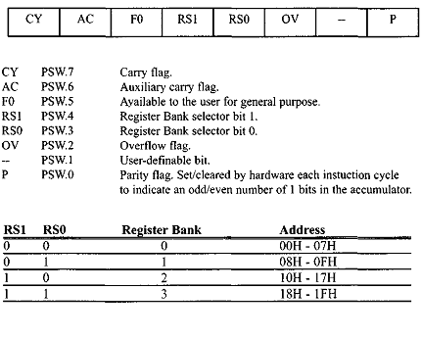
Figure: Bits of the PSW Register

Slide 13
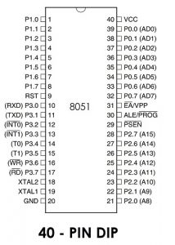
Pin diagram of 8051 Microcontroller –
The 8051 Microcontroller is a 40-pin Plastic Dual Inline Package (PDIP). The functions of the pins of this Microcontroller are as follows :

Slide 14
Ports of 8051 Microcontroller –
Port 0 –
The Port 0 or P0 is a General Purpose I/O Port. Consequently, it consists of 8 pins starting from pin 32 to pin 39. However, this port can also be utilized as a multiplexed Address and Data bus (from AD0 to AD7).
Port 1 –
The Port 1 or P1, is also an 8-bit port starting from pin 1 to pin 8. Although similar to the P0, the P1 is also a General Purpose I/O Port, however, unlike the other three ports, P1 does not serve any dual purpose. Hence the sole purpose of P1 is for interfacing.
Port 2 –
The pins from 21 to 28 belong to the Port 2, or P2. Now when there is no presence of an external memory, the P2 act as a General Purpose I/O Port. However, in the presence of external memory, P2 acts as an Address Bus, starting from A8 to A15.

Slide 15
Port 3 –
Though the Port 3 or P3 usually acts as a normal I/O Port, it can provide some other functions as well. The pin numbers are from 10 to 17. The other functions are below.
Pin10 – RXD Pin11 – TXD Pin12 – INT0 complement
Pin13 – INT1 complement Pin14 – T0 Pin15 – T1
Pin16 – WR complement Pin17 – RD complement
Additionally, the other pins are as follows –
Pin20 – GND (Ground) Pin40 – VCC (Supply) Pin9 – RST (Reset)
Pin18 – XTAL1 (Oscillator) Pin19 – XTAL2 (Oscillator)
Pin29 – PSEN (Program Store Enable) Pin30 – ALE (Address Latch Enable)
Pin31 – EA (External Access)

Slide 16
Pins 1 to 8 − These pins are known as Port 1. This port doesn’t serve any other functions. It is internally pulled up, bi-directional I/O port.
Pin 9 − It is a RESET pin, which is used to reset the microcontroller to its initial values.
Pins 10 to 17 − These pins are known as Port 3. This port serves some functions like interrupts, timer input, control signals, serial communication signals RxD and TxD, etc.
Pins 18 & 19 − These pins are used for interfacing an external crystal to get the system clock.
Pin 20 − This pin provides the power supply to the circuit.
Pins 21 to 28 − These pins are known as Port 2. It serves as I/O port. Higher order address bus signals are also multiplexed using this port.

Slide 17
Pin 29 − This is PSEN pin which stands for Program Store Enable. It is used to read a signal from the external program memory.
Pin 30 − This is EA pin which stands for External Access input. It is used to enable/disable the external memory interfacing.
Pin 31 − This is ALE pin which stands for Address Latch Enable. It is used to demultiplex the address-data signal of port.
Pins 32 to 39 − These pins are known as Port 0. It serves as I/O port. Lower order address and data bus signals are multiplexed using this port.
Pin 40 − This pin is used to provide power supply to the circuit.

Slide 18
The Applications of 8051 Microcontroller
8051 Microcontroller have wide uses in a variety of applications. Thus from our daily lives, to industrial applications, it is no doubt that Microcontroller is omnipresent. So here is a list of some of the major applications incorporating the 8051 Microcontroller –
Robotics – Robotics is a technology that is on the exponential increase. This industry relies heavily on the Microcontrollers for their development. Hence, the 8051 is used widely in the Robotics industry.
IoT – The Internet of Things technology is a booming industry of 2018. Furthermore this new technology has been creeping into almost all of he industries in the world. Thus, the use of Microcontroller has increased as this is a vital component for any smart device.
Temperature and Light sensing devices.
Process Control Devices.

